Slide 1
02 - Numpy
Machine Learning

Slide 2
Course Overview:
1.1 - Python Review
1.2 - Numpy
1.3 - Pandas
1.4 - Seaborn
2.1 - ML Intro
2.2 - Linear Regression
2.3 - Logistic Regression
2.4 -Naïve Bayes Classifier
2.5 - KNN
2.6 - Decision Trees
3.1 – Ensembling Learning
3.2 - Neural Networks
4.* - Natural Language Processing (NLP)
5.* Competition Tips & Final Thoughts

Slide 3
Intro - What is Numpy?
01
Installation
02
TABLE OF CONTENTS
Arrays
03
Operations
04

Slide 4
01
What is Numpy?

Slide 5
Numpy
Linear algebra library commonly used for data science
Used for manipulating and storing data in arrays, which is useful for creating and using data from pandas dataframes (covered in chapter 3)
Many libraries rely on and use numpy architecture

Slide 6
02
Installation

Slide 7
Installation
In Command Prompt:
> conda install numpy ---OR--- > pip install numpy
Importing in Python:
import numpy as np # this imports numpy!

Slide 8
03
Arrays - Basics

Slide 9
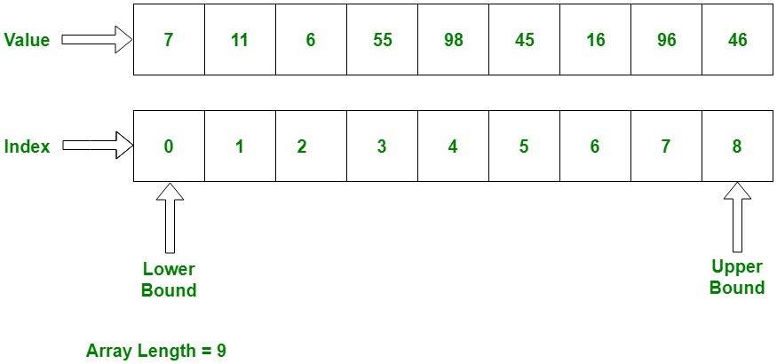
Arrays
Similar to a list, but must have identical data types.
Can be used to contain things like numbers, strings, and even other arrays.
An array with other arrays in it is called a 2d array or a matrix.
Every item in an array is assigned an index, depending on its position. This lets us easily access data from arrays.

Slide 10
Arrays (cont.)
Syntax:
np.array(name of list)
While a list can have different data types ([0, ‘happy’, True]), an array must have the same data types.

Slide 11
Useful array methods
np.arange(start, stop, step) can be used to create a quick list of numbers arranged in a linear fashion
np.zeros()
np.zeros(3) create an vector of 3 zeroes
np.zeros((2,3)) create a matrix of 2 rows and 3 columns
np.ones()
np.ones(4) create a vector of 4 ones
np.ones((3,4)) create a matrix of 3 rows and 4 columns

Slide 12
Useful array methods (cont.)
np.linspace(start, stop, # of points) can be used to create an array of a number of evenly spaced points between two given numbers
np.eye(4) creates a square matrix (# of rows = # of columns). All zeroes except for a diagonal of ones. This is called an identity matrix, which is useful for linear algebra problems

Slide 13
Useful array methods (cont.)
arr = np.array([1,2,3,4])
arr.reshape(2,2) = reshapes the array
arr.max() returns maximum value in array
arr.min() returns minimum value in array
arr.argmax() returns index of maximum value
arr.argmin() returns index of minimum value

Slide 14
Useful array methods (cont.)
arr.shape returns shape of array (# of rows, # of columns)
arr.dtype returns data type of array

Slide 15
04
INDEXING

Slide 16
What is indexing?
An index is a number that refers to an item in a certain position in a data type with multiple values.
Indexing is similar to that of lists for NumPy arrays.

Slide 17
Indexing basics
Lists and arrays are indexed starting from 0
Matrices are indexed as such: mat[row index][column index] or mat[row, col]
Example:
Matrixx = [[1,2,3][4,5,6][7,8,9]]
Matrixx[0][0] = 1
Matrixx[1] = [4,5,6]

Slide 18
Slicing
Start-stop-step, or slice notation, is a method of grabbing parts of an array or list
[0:5] returns the values from index 0 to 5
[:6] returns everything up to index 6
Arr[5:] returns index 5 and everything beyond
Slice notation can be used in indexing matrices as well as vectors
Broadcasting uses slice notation to change the values of certain values in an array
Arr[0:5] = 100
array([100, 100, 100, 100, 100, 6, 7, 8, 9, 10])

Slide 19
Miscellaneous array functions
arr.copy() copies the array so that changes can be made to a copy of the array while leaving the original data intact
Arr > 5 creates a new array that only has true or false based on which numbers are greater than 5. This can be used to create a new array that only has those values. Arr[Arr>5]
np.where() allows you to find the index of an item in an array based off of its properties

Slide 20
05
ARRAY OPERATIONS

Slide 21
Operations
Addition/Subtraction/Multiplication/Division will use the same syntax
a = [1, 1, 1], b = [1,1,2]
a + b= [2, 2, 3]
Note: be wary of the dimensions of the matrix and also don’t divide by 0 because you will get “inf”.

Slide 22
Thank you!

